Slide 1
Functions: Injection, Surjection, Bijection

Slide 2
Section Summary
Definition of a Function:
Domain, Cdomain
Image, Preimage
Injection, Surjection, Bijection
Inverse Function
Function Composition

Slide 3
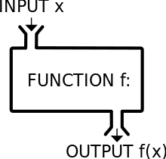
Functions
Definition: let A and B be nonempty sets, a function f from A to B, denoted by f : A → B, is an assignment of each element of A to exactly one element of B.
We write f (a) = b if b is the unique element of B assigned by the function f to the element a of A.
Functions are sometimes
called mappings or
transformations.

Slide 4
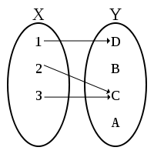
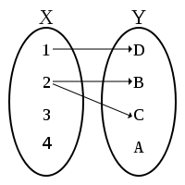
Functions
Example: f : A → B, is an assignment of each element of A to exactly one element of B.
Students
Grades
A
Carlota Rodriguez
B
Sandeep Patel
C
Jalen Williams
D
NO!
Kathy Scott
F
YES!
NO!

Slide 5
Functions
A function f : A → B can also be defined as a subset of A×B (a relation). This subset is restricted to be a relation where no two elements of the relation have the same first element.
Specifically, a function f from A to B contains one and only one ordered pair (a , b) for every element a ∈ A; first element.
and

Slide 6
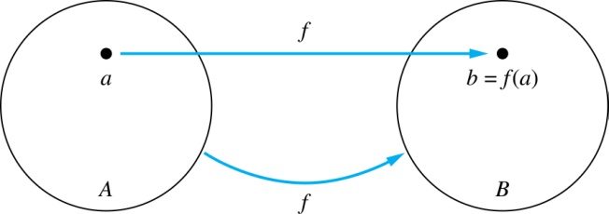
Functions
Given a function f : A → B. We say f maps A to B,
A is called the domain of f,
B is called the codomain of f.
If f (a) = b ,
then b is called the image of a under f,
a is called the preimage of b.
“f (a)” is also known as the range.
Two functions are equal when they have the same domain, the same codomain and map each element of the domain to the same element of the codomain.

Slide 7
Representing Functions
Functions may be specified in different ways:
An explicit statement of the assignment.
For instance, students and grades example.
A formula:
f(x) = x + 1
A computer program:
A Java program that when given an integer n, produces the n^{th} Fibonacci Number.

Slide 8
Questions
A
B
f (a) = ?
z
a
The image of d is ?
z
x
The domain of f is ?
A
b
y
c
The codomain of f is ?
B
z
d
The preimage of y is ?
b
The preimage(s) of z is (are) ?
{a, c, d}

Slide 9
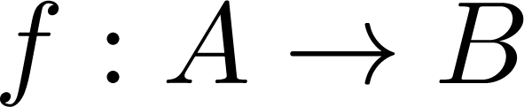
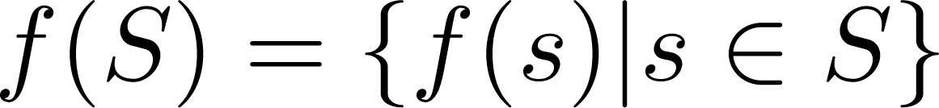
Question on Functions and Sets
If and S is a subset of A, then
A
B
a
x
f ({a, b, c}) is ?
{y, z}
b
y
c
f ({c, d}) is ?
{z}
z
d

Slide 10
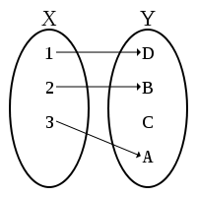
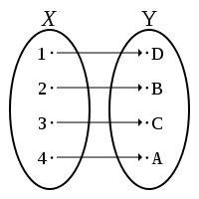
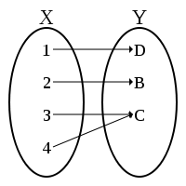
Injections
Definition: a function f is said to be one-to-one if and only if for all a and b in the domain, f (a) = f (b) implies that a = b.
A function is said to be an injection if it is one-to-one.
YES!
YES!
NO!

Slide 11
Surjections
Definition: a function f from A to B is called onto, if and only if for every element b ∈ Y, there is an element a ∈ X with f (a) = b.
A function f is called a surjection if it is onto.
NO!
YES!
YES!

Slide 12
Bijections
Definition: a function f is a bijection (one-to-one correspondence), if it is both one-to-one and onto, i.e., both surjective and injective.
A
B
a
x
b
y
c
d
z
YES!
w
NO!
surjection but not injection

Slide 13
Showing that f is one-to-one or onto
Example 1: let f be a function from { a, b, c, d } to { 1, 2, 3 } defined by f (a) = 3, f (b) = 2, f (c) = 1, and f (d) = 3. Is f an onto function?
Solution: Yes, f is onto since all three elements of the codomain are images of elements in the domain. If the codomain were changed to { 1, 2, 3, 4 }, f would not be onto.
Example 2: is the following function f (x): Z → Z, where Z is the set of integers and f (x) = x² onto?
Solution: No, f is not onto because, e.g., −1 in the codomain does not have a preimage in the domian.

Slide 14
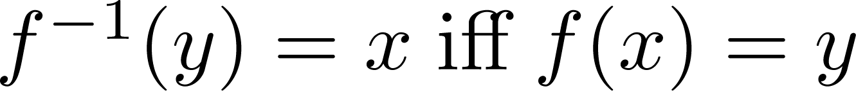
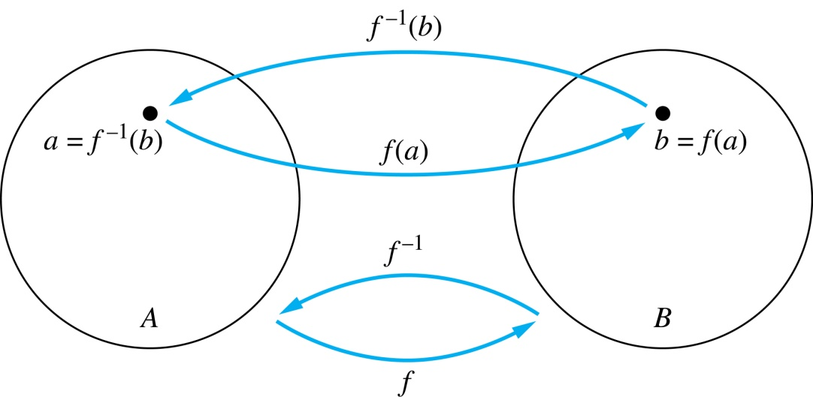
Inverse Functions
Definition: let f be a bijection from A to B. Then the inverse of f, denoted by f ⁻¹, is the function from B to A defined as
No inverse exists unless f is a bijection.

Slide 15
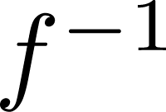
Inverse Functions
A
f
B
A
B
a
V
a
V
b
b
W
W
c
c
X
X
d
d
Y
Y

Slide 16
Questions
Example 1: let f be the function from { a, b, c } to {1, 2, 3 } such that f (a) = 2, f (b) = 3, and f (c) = 1. Is f invertible and if so, what is its inverse?
Solution: the function f is invertible because it is a one-to-one correspondence (bijection).
The inverse function f ⁻¹ reverses the correspondence given by function f, therefore, f ⁻¹ (1) = c, f ⁻¹ (2) = a, and f ⁻¹ (3) = b.

Slide 17
Questions
Example 2: let f : Z → Z be such that f (x) = x + 1. Is f invertible, and if so, what is its inverse?
Solution: the function f is invertible because it is a one-to-one correspondence (bijection). The inverse function f ⁻¹ reverses the correspondence so f ⁻¹ (y) = y – 1.
Z
Z
…
-2
-1
-1
0
0
1
1
2
…

Slide 18
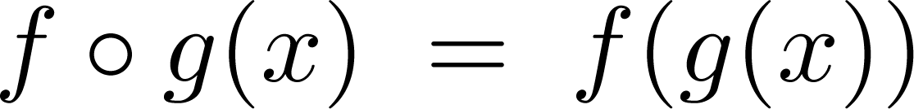
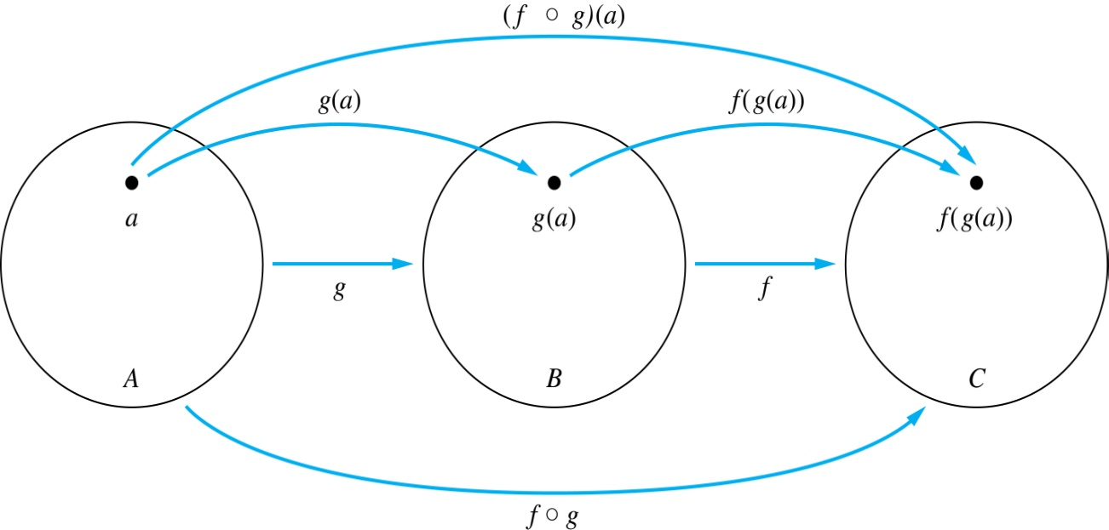
Composition
Definition: let f : B → C , g : A → B. The composition of function f with function g, denoted by f o g, is a function from A to C defined by

Slide 19
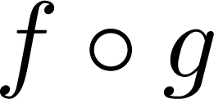
Composition
A
g
B
f
C
A
C
a
V
h
a
h
b
i
b
W
c
i
c
d
X
j
d
j
Y

Slide 20
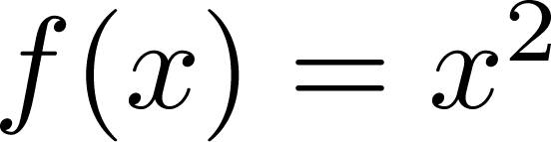
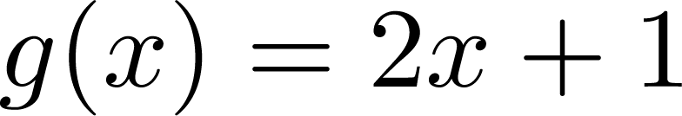
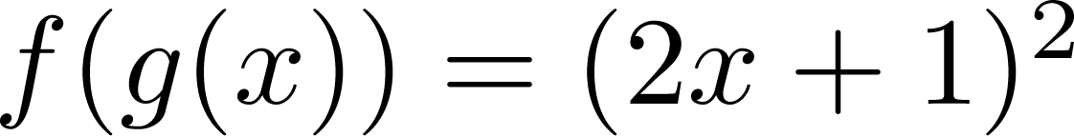
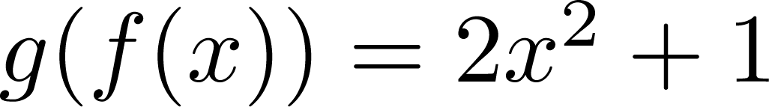
Composition
Example 1: if and , then
and
Since f ( g (x) ) = f ( 2x+1 ) = ( 2x+1 )²
and g ( f (x) ) = g ( x² ) = 2 (x²) +1 = 2 x² +1

Slide 21
Composition Questions
Example 2: let g be the function from the set { a , b , c } to itself such that g (a) = b, g (b) = c, and g (c) = a. Let f be the function from the set { a , b , c } to the set {1 , 2 , 3 } s.t. f (a) = 3, f (b) = 2, and f (c) = 1.
What are the compositions of f ∘ g and g ∘ f ?
Solution: The composition f ∘ g is defined by
f ∘ g (a) = f (g (a)) = f (b) = 2.
f ∘ g (b) = f (g (b)) = f (c) = 1.
f ∘ g (c) = f (g (c)) = f (a) = 3.
Note that g ∘ f is not defined, because the codomain of f is not a subset of the domain of g.

Slide 22
Composition Questions
Example 2: let f and g be functions from the set of integers to the set of integers defined by f (x) = 2x + 3 and g (x) = 3x + 2.
What is the composition of f and g, and also the composition of g and f ?
Solution:
f∘g (x)= f (g (x)) = f (3x + 2) = 2(3x + 2) + 3 = 6x + 7
g∘f (x)= g (f (x)) = g(2x + 3) = 3(2x + 3) + 2 = 6x + 11

